Slide 1

Development of Health Web App with integration of ensemble machine learning algorithms for early diagnosis of obesity-related chronic diseases
Capstone Project (C3879C)
Name: WONG QI YUAN, JEFFREY
Course: Specialist Diploma in Applied Artificial Intelligence (Intake 5)

Slide 2
What problem are we currently facing now and the future?
The World Health Organization (WHO) mentioned in a recent report that obesity-related chronic diseases have contributed to approximately about 41 million premature deaths annually, which is about 71% of all death worldwide. If the situation is unresolved, we are expected that the overall number of obesity-related chronic diseases related-deaths to be increased up to 52 million yearly by the end of 2030. The most common obesity-related chronic diseases are the obesity, diabetes and hypertension.
Furthermore, as the world currently facing the crisis of the COVID-19 pandemic, hence it would be expected that the number of people developing the obesity-related chronic diseases to rise as most people are working from home in order to curb the spread of the COVID-19 in their communities. Also, based on the recent news article, about 1/3 of the Singaporeans have gained weight during the COVID-19 pandemic and many fingers point their fingers at how their lifestyles have changed to become sedentary since the COVID-19 pandemic.
Thus, this is an alarming concern in the road of the battle of the COVID-19 pandemic as the majority of the people are unaware of their overall obesity status and some of them do not have time to for a simple health screening.

Slide 3

Overview of the project context
Prior to training the algorithms, three datasets (i.e., diabetes, hypertension, and obesity) were downloaded from various sources.
Followed by, the implementation of the Isolation Forest to detect and removed the potential outliers, and then performed data splitting in the ratio of 70:30 such that 70% training data and 30% testing data.
As the classes are imbalanced for all the training sets, the SMOTE-TOMEK technique was used to balance the training data distribution to minimized the biased and unreliable outcomes on the machine learning model performance.
Implementation of the classifiers algorithms (random forest, gradient boosting , and extra trees) with hyperparameters optimization to predict the respective possible risk of developing obesity-related chronic diseases such as obesity, diabetes, and hypertension.
To simulate the real-life practical application, a web application was implemented using Streamlit with the integration of the respective proposed classifier models to predict the likelihood of developing of the respective obesity-related chronic diseases.

Slide 4


Benefits of using the health app
It would provide an individual to know their likelihood (probability) of being developing the obesity-related chronic-diseases such as diabetes, hypertension, and obesity, and hence, reduce their time to visit the office clinic in person.
Being cost-effective, the users are able to know the diagnosis right on the spot and also provide the users the time to prevent and manage the chronic-diseases by making them aware of their present condition.
Who are the target users?
Anyone who are self-conscious about own health status.
Anyone who seldom or have no intention to visit the clinics or hospitals on regular basis for health screening.

Slide 5






Basic COncepts of obesity-related chronic diseases
Diabetes is a metabolic disorder that changes the blood sugar levels in the blood stream. When there is insufficient insulin or cells stop responding to insulin, too much sugar will remain in the bloodstream. Over time, this usually leads to consequences of health issues such as vision loss, kidney failure, skin disorders, etc.
Hypertension or High Blood Pressure is a blood pressure that is usually higher than the global health recommended blood pressure (< 140/120 mmHg). However, high blood pressure that is consistently above the recommended range may result in kidney failure, stroke, heart diseases, etc.
Obesity can be defined as a weight that is higher than what is considered healthy for a given weight. Obesity is a serious diseases as it is often related with poor mental health and reduced quality of life, and also leading causes of death, diabetes, and high blood pressure.

Slide 6
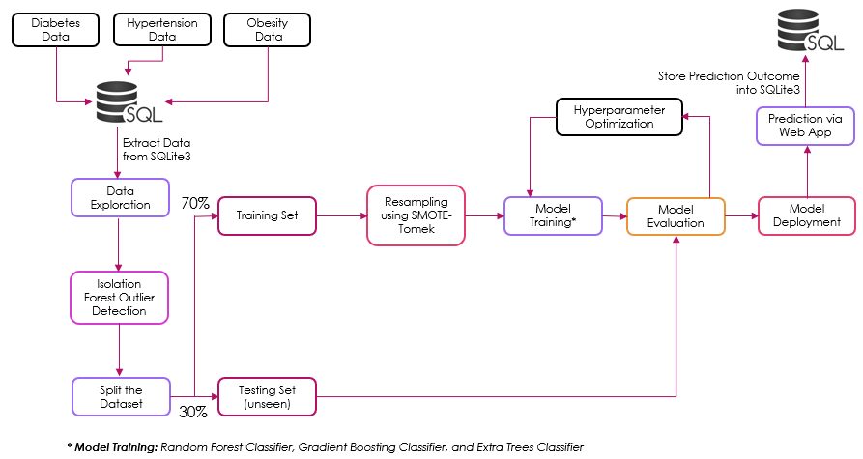
Machine Learning Workflow

Slide 7
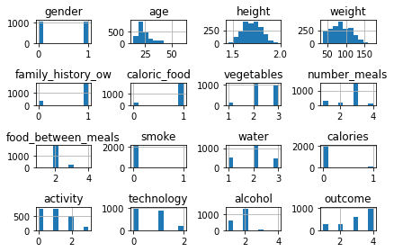
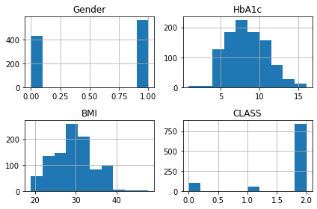
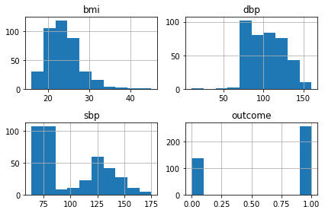
1) Data Exploration (Histogram)
Obesity
Diabetes
Hypertension
Based on all the above histogram subplots shown above, it would be expected to scale the distributions to the same range to be useful for modelling algorithms at the later stage, and perhaps the use of scaling techniques such as power transform, min max scaler, and/ or standard scaler at the modelling stage.

Slide 8
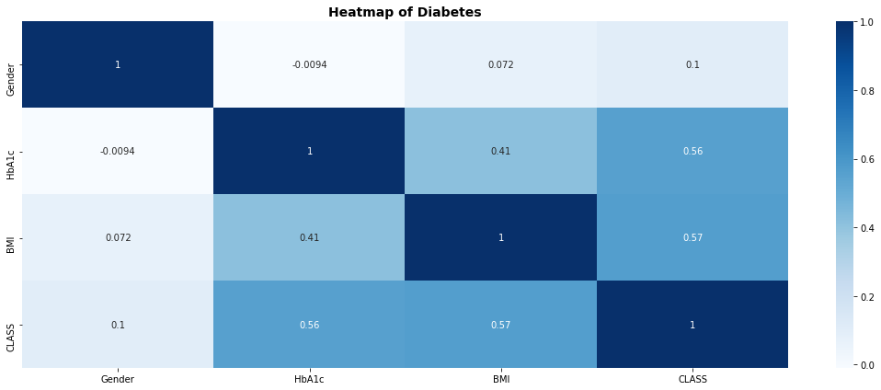
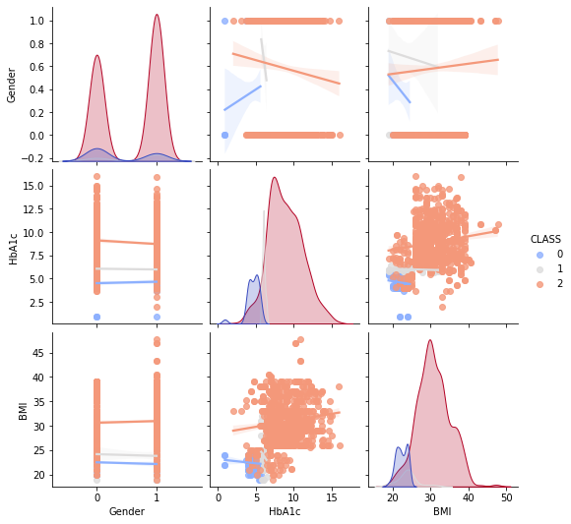
1) Data Exploration (Heatmap and pair-plot) - Diabetes
Based on the heatmap and pair-plot, both show that there is a weak and positive correlation between HbA1c and BMI attribute, but the impact on the overall algorithm’s performance is generally small.

Slide 9
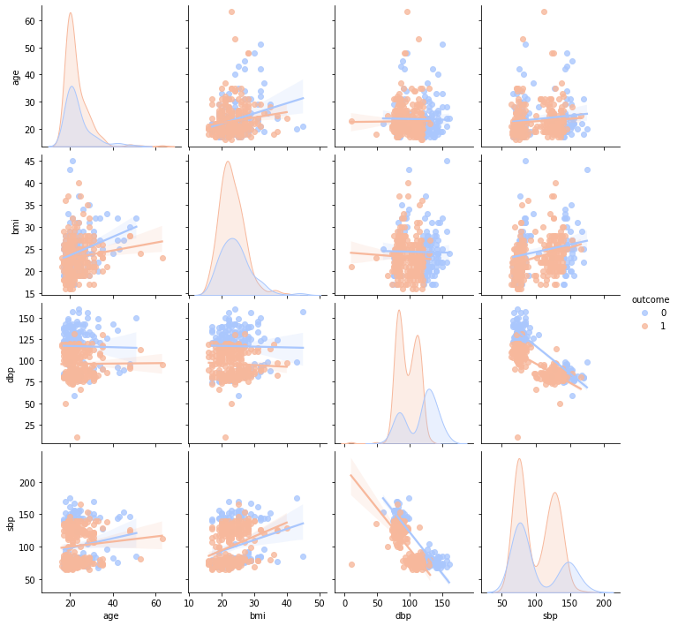
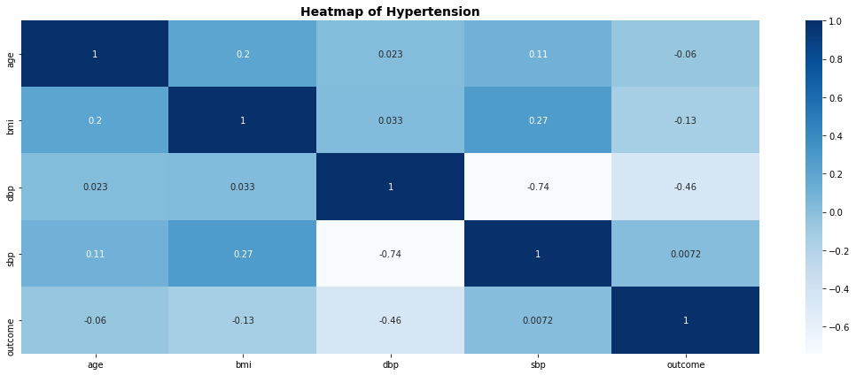
1) Data Exploration (Heatmap and pair-plot) - Hypertension
Based on the heatmap and pair-plot, both show that there is a no significant correlation between variables.

Slide 10
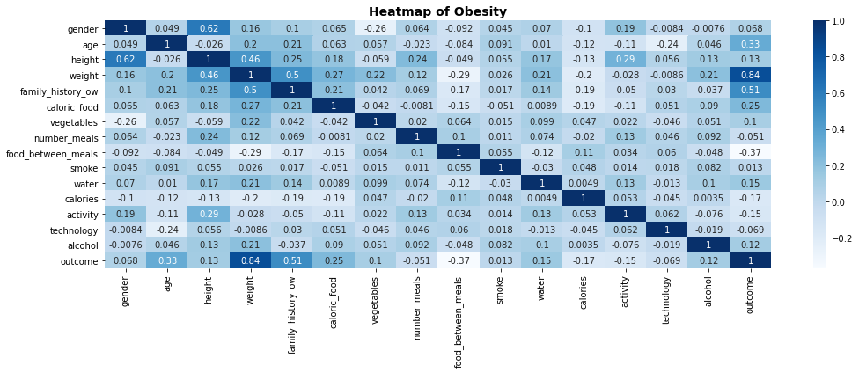
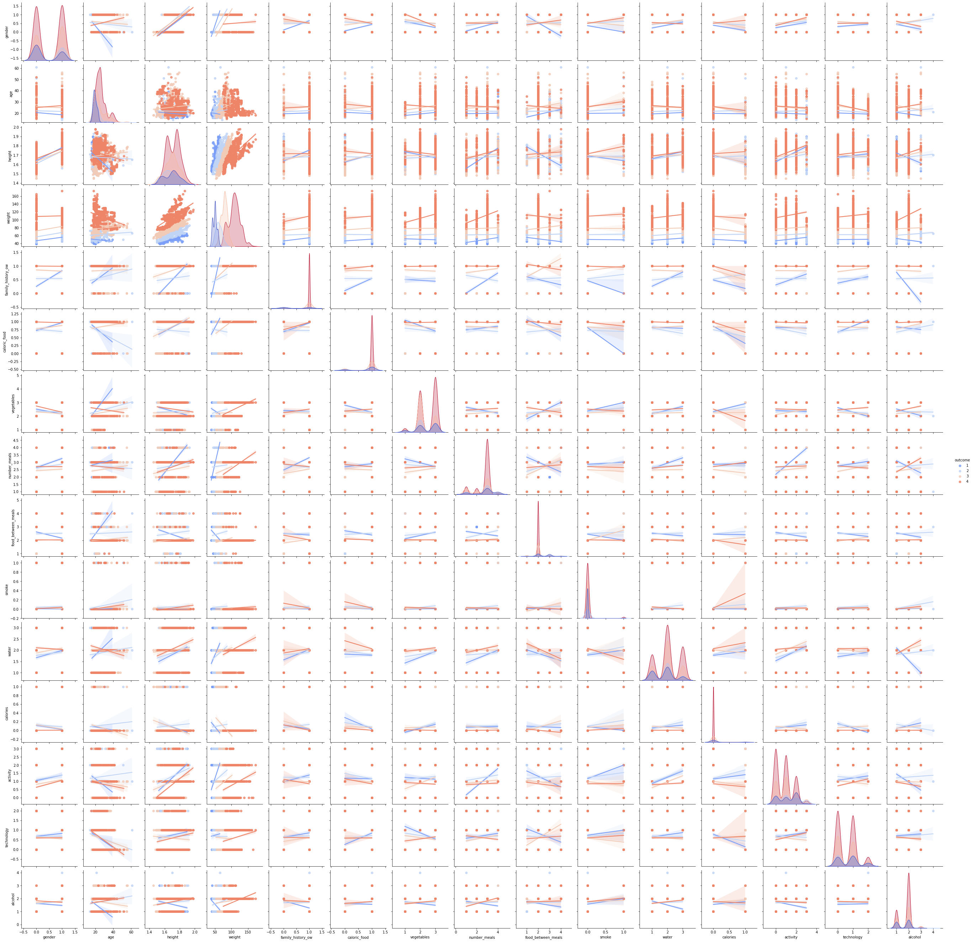
1) Data Exploration (Heatmap and pair-plot - Obesity)
Based on the heatmap and pair-plot, both show that there is a weak and positive correlation between height, weight, and family history with overweight attributes, but the impact on the overall algorithm’s performance is also generally very small.

Slide 11
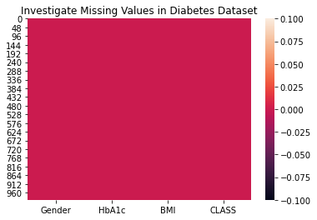
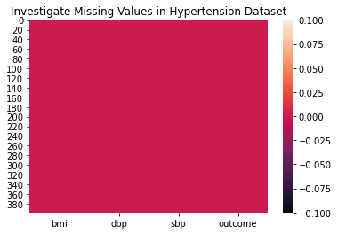
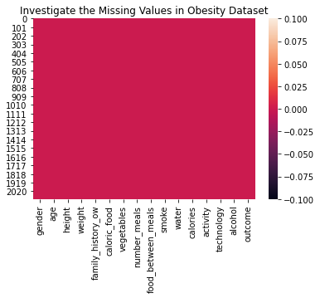
2) Data cleansing – investigation of missing data
Prior to the algorithms training, it is imperative to investigate for missing data during the pre-processing steps as not all machine learning algorithms support missing values and might have a chance of leading to inaccurate and bias outcome.
Based on the heatmaps shown below, there were no missing row data found in all three datasets.

Slide 12
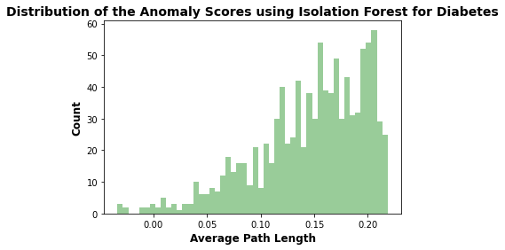
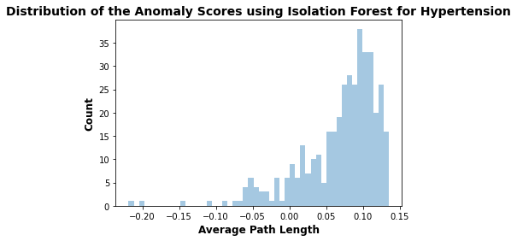
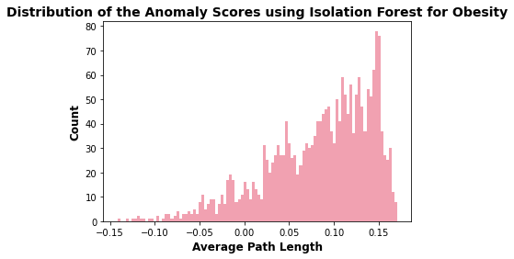
3) Data cleansing – Removal of potential outliers using isolation forest
Isolation Forest is the anomaly detection algorithm that identifies anomalies using Isolation. As such, the isolation forest was used to identified the potential outliers data in the respective datasets.
Basically, the iForest works by creating an ensemble of isolation forest trees for each dataset where outliers were as instances with short average length in the trees. The tree is then recursively created by dividing the dataset until all instances are isolated or specific tree height is achieved.
Outliers
Outliers
Outliers
Based on the anomaly scores distribution shown above, the outliers with the lower anomaly scores are likely to be outliers. As such, the outlier threshold on the score can be set by the user preference to differentiate between the outlier and inlier. In this case, the outlier threshold was set as below -0.01 for all data aspects.
Thereafter, the outlier data from each dataset was removed, and the remaining data were used for further modelling algorithms.

Slide 13
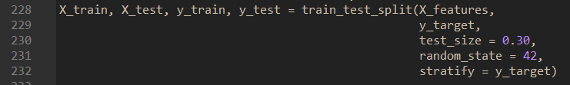
4) Data splitting
All the respective pre-processed datasets were divided into 70% training set and 30% testing set.
A sample code snippet of dividing the datasets.
70% Training | 30% Testing

Slide 14
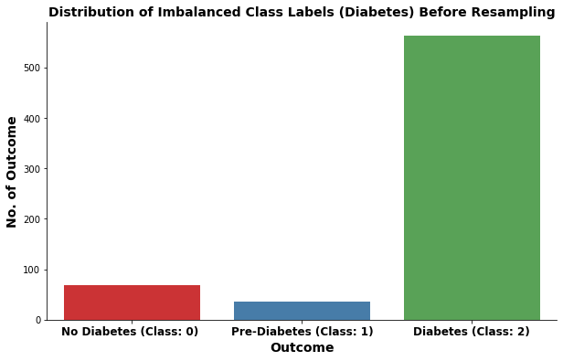
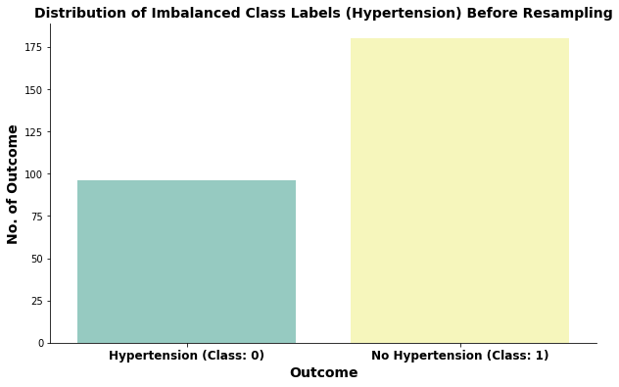
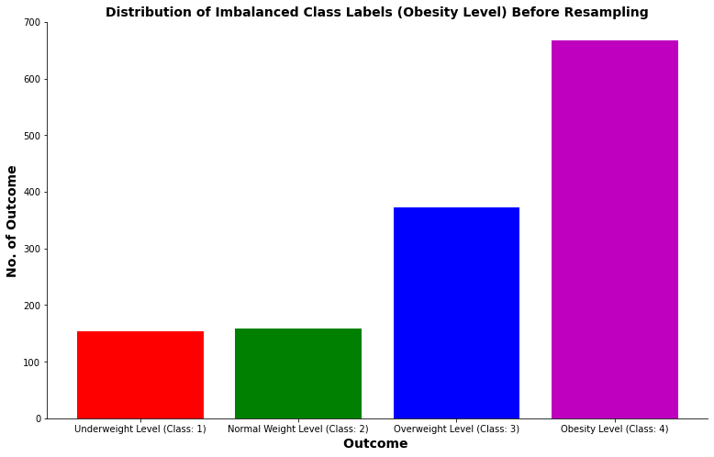

5) Resampling Technique (SMOTE-TOMEK)
After splitting the datasets, it was also observed that all of the classes present in the respective training sets were imbalanced. Hence, it is also imperative to balance the datasets prior to the modelling pipeline.
This is because if the imbalanced training data is not treated promptly prior to the modelling pipeline, this will degrade the performance of the classifier models.
As such, most of the predictions will correspond to the majority class and treat the minority class features as noise in the data and resulting in high bias in the models.
Therefore, resampling is one of the most commonly approach to achieve the aim and deal with the imbalanced training datasets.

Slide 15

5) Resampling Technique (SMOTE-TOMEK)
Even though SMOTE is one of the famous oversampling techniques and is very effective in handling class imbalance. The idea is to combine the SMOTE with Tomek to increase the effectiveness of handling the imbalanced class in training set.
Basically, SMOTE is an oversampling technique that creates synthetic minority class data points to balance the training set. It works using a k-nearest neighbor algorithm to create synthetic data points.
As for Tomek Links, it is an under-sampling approach that identifies all the pairs of data points that are nearest to each other but belong to different class, and these pairs are termed as Tomek Links. If these Tomek link points are present on the boundary of separation of the two classes. So removing the majority class of Tomek links points increases the class separation, and reduces the number of majority class samples along the boundary of the majority cluster.

Slide 16
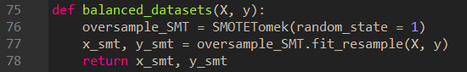
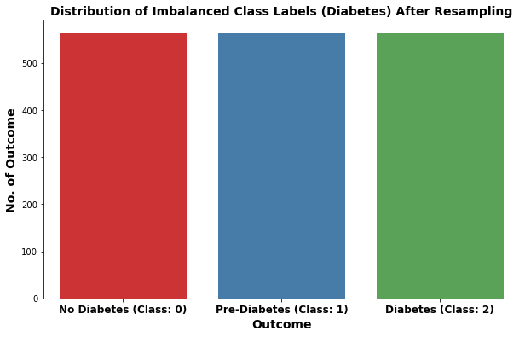
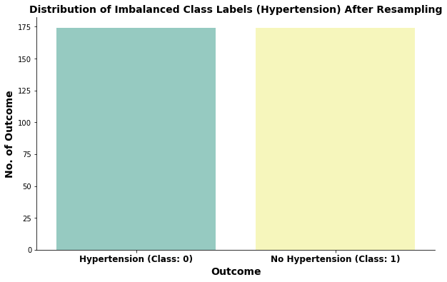
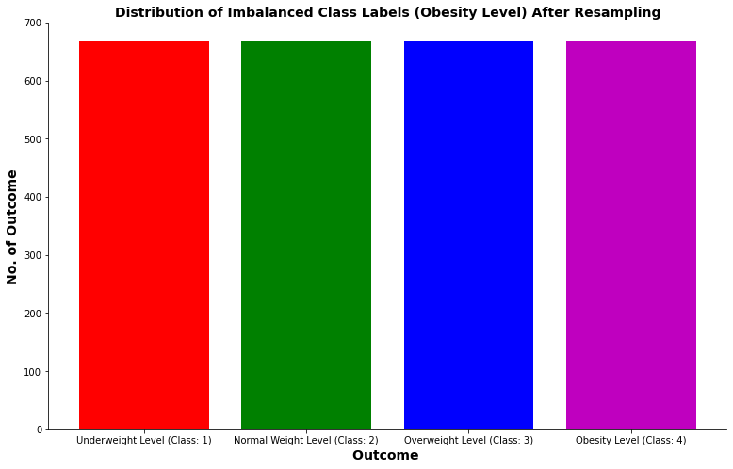
5) Resampling Technique (SMOTE-TOMEK)
Below shows a sample code snippet of the implementation of SMOTE and Tomek Links using the Imblearn package.
Below are the outcomes of the balanced classes in the training sets using SMOTE-Tomek Technique.
A sample code snippet of resampling technique (SMOTE-TOMEK)

Slide 17
6) Baseline Model Selection & evaluation
The baseline of the classifier machine learning algorithms were built with the default parameters to investigate how well does each algorithm performed with the respective training datasets.
A sample code snippet of the baseline using the default parameters.
A model pipeline was also built by providing the list of steps. Each step represents a tuple containing a string of name and an instance of an estimator.
A sample code snippet of the model pipeline of hypertension.
A sample code snippet of the model pipeline of obesity and diabetes.

Slide 18
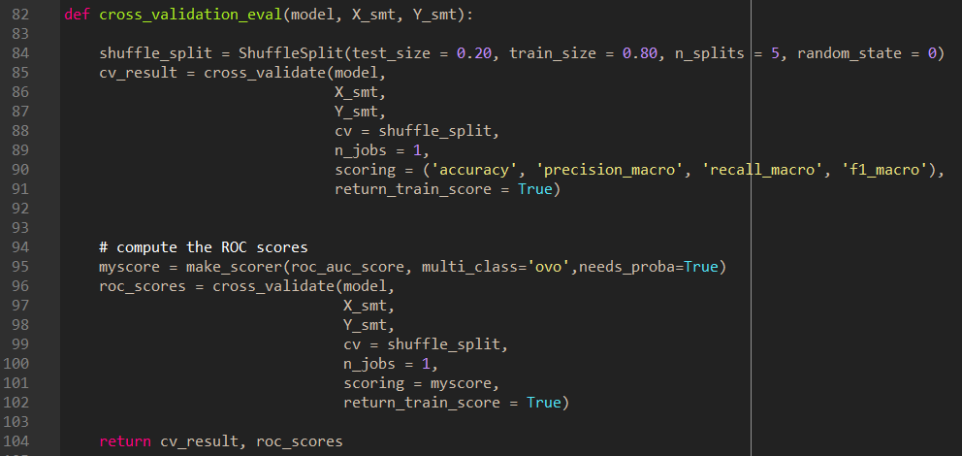
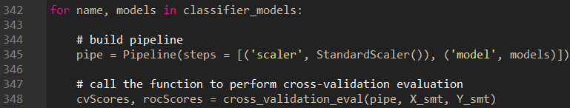
6) Baseline Model selection & evaluation
After the baseline model pipelines were implemented, the Shuffle-Split Cross Validation was implemented to assess the performance and general errors of the entire classification algorithms.
Shuffle-Split Cross-Validation allows for control over the number of iterations independently of the training and test sizes and also allows for using the only part of the data in each iteration, by providing the train size and test size setting that don’t add up to one.
Therefore, shuffle-split cross-validation provides a more reliable result for classification tasks.
For this case, the train size and test (validation) size has been set as 80% and 20% respectively. One must note that the test used in the cross-validation was not originated from the testing set. In other words, the test used in the cross-validation was actually the % split from the training set itself.
A sample code snippet of Shuffle-Split Cross-Validation for Baseline Models

Slide 19
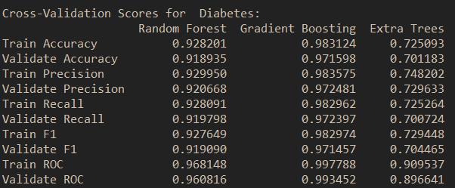
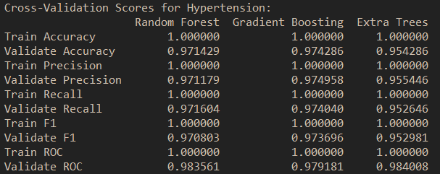
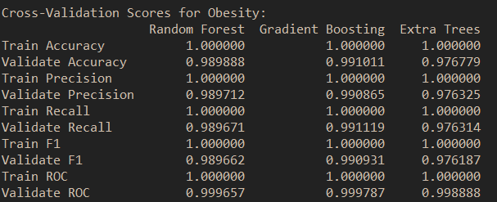

6) Baseline Model selection & evaluation
The gradient boosting classifier was selected as the baseline model for diabetes as it shows the only best performance metrics as compared to the rest of the other classifiers.
The random forest classifier was selected for hypertension because of its model characteristics such that it is less biased and exhibits moderate variance in nature.
Similar to hypertension, the random forest classifier was selected for obesity because of its model characteristics such that it is less biased and exhibits moderate variance in nature.

Slide 20
7) Hyperparameter Optimization
The objective of hyperparameter optimization is to find the most optimal hyperparameters in machine learning classifiers.
Before the hyperparameter optimization process, a model pipeline object was first built by providing it with a list of steps and each steps represents a tuple containing a string of name and an instance of an estimator.
Below shows the sample code snippets for the respective obesity-related chronic diseases with the chosen baseline models.
A sample code snippet of model pipeline (Diabetes)
A sample code snippet of model pipeline (Hypertension)
A sample code snippet of model pipeline (Obesity)

Slide 21
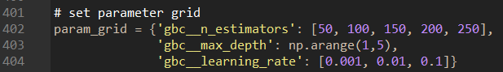
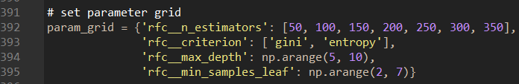
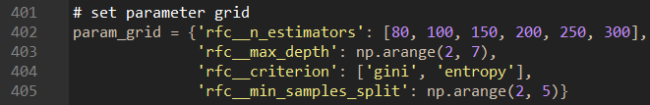
7) Hyperparameter Optimization
Next, it is the construction of the parameter grid such that it is to specify for each parameter the step, followed by __ a double underscore, followed by the parameter name. To search over the n_estimator parameter, for example in the random forest classifier, the “rfc__n_estimator” was used as key in the parameter grid dictionary, and similar for the rest of the other parameters.
Below shows the sample code snippets for the construction of the parameter grid for each respective chosen baseline model.
A sample code snippet of model pipeline (Diabetes)
For Gradient Boosting Classifier, the most important parameters to be optimized are the number of trees n_estimators and learning_rate, which controls the degree to which each tree is allowed to correct the mistakes of the previous trees. These two parameters are highly interconnected such that a lower learning_rate means that more trees are required to build a model in more complexity. Similar as random forest, a higher n_estimators are always better. But however, increasing n_estimators in gradient boosting will leads to a model complexity, which may lead to overfitting. Furthermore, another important parameter is max_depth, it is to minimizes the complexity of each tree. Usually, max_depth is set to a very low split in gradient boosted models, often no deeper than five splits.
A sample code snippet of model pipeline (Hypertension)
For Random Forest Classifier, the most important parameters to be optimized are n_estimators, criterion, max_depth, and min_samples_leaf. For n_estimators, the larger is always better, and averaging more trees will yield a more robust ensemble by minimizing overfitting. However, there are some drawbacks, more trees need more memory and more time to train. In general, a smaller max_features reduce overfitting and it is a good rule of thumb to use the default values for max_features: max_features=sqrt(n_features) for classification problems. Furthermore, adding min_samples_leaf might sometimes also improve performance.
A sample code snippet of model pipeline (Obesity)

Slide 22
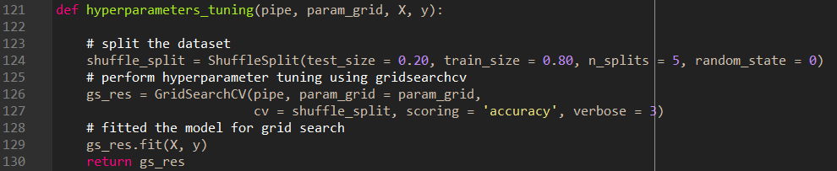
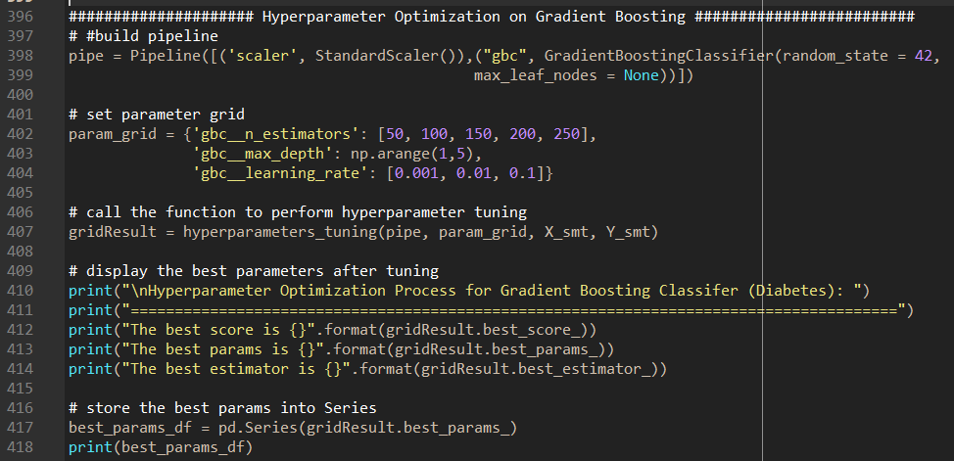
7) Hyperparameter Optimization
Finally, a GridSearchCV function was implemented to search the best or optimal hyperparameters based on the best scores.
For each split in the Cross-Validation, the Min-Max-Scaler or Standard Scaler is refit only with the training splits and no information was leaked from the testing split into the parameter search.
As mentioned in the earlier slides, the testing split was not based on the testing set. It is the defined amount of the % split from the training set.
Furthermore, to get a finer control over the cross-validation, the CV parameter in the GrdiSearchCV function uses Shuffle-Split and the amount of split were defined as 80% training and 20% testing (validation) sets.
On the right, it shows a sample code snippet of the hyperparameter optimization.
A sample code snippet of Grid Search CV (Hyperparameter Optimization)

Slide 23
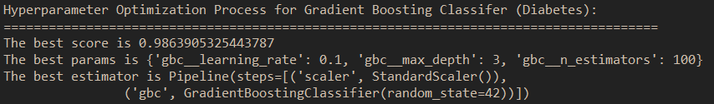
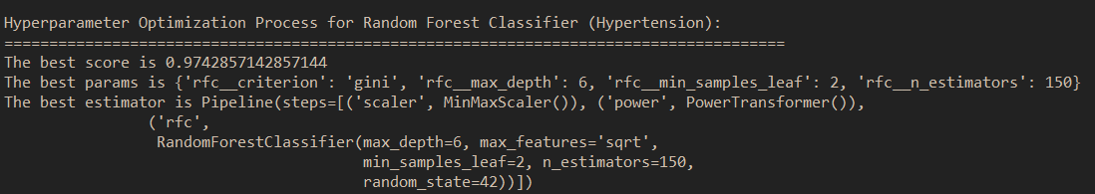
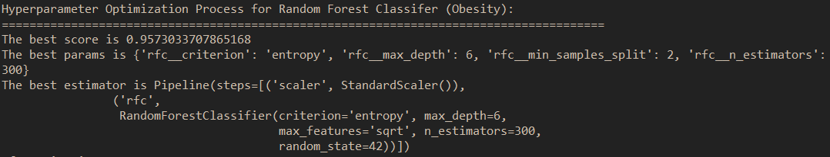
7) Hyperparameter Optimization
Below show the outcome of the hyperparameter optimization for the respective classifier model for respective obesity-related chronic diseases.
Outcome of the Hyperparameter Optimization for Gradient Boosting Classifier (Diabetes)
Outcome of the Hyperparameter Optimization for Random Forest Classifier (Hypertension)
Outcome of the Hyperparameter Optimization for Random Forest Classifier (Obesity)

Slide 24
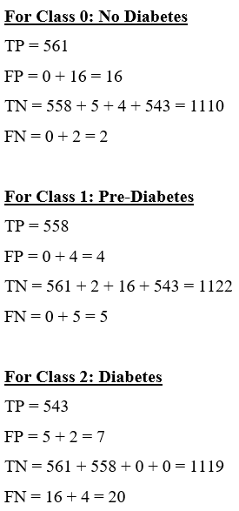
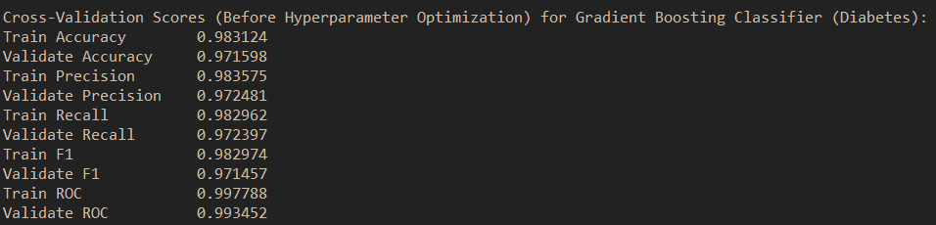
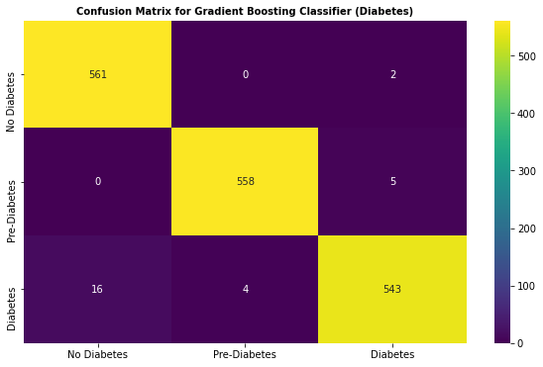
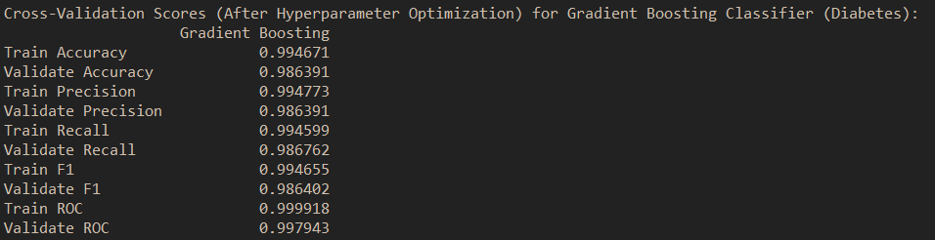
8) Retrained Model with best hyperparameter and Evaluation
Diabetes (Gradient Boosting Classifier)
Before Hyperparameter Optimization
After Hyperparameter Optimization
With the best hyperparameters, the Gradient Boosting Classifier for Diabetes produces a very high accuracy rate of 99%.
High precision rates also relates to the low-false positive rate, which is aggregable with the confusion matrix calculation shown on the right, which is about less than 5% chances for all classes.
Also, high recall rates also relates to the low-false negative rate, which can be also proven from the confusion matrix, which is also about less than 5% chances for all classes.
ROC-AUC with 99% means that the Gradient Boosting Classifier has the excellent capability to differentiate between classes (i.e., No Diabetes, Pre-Diabetes, and Diabetes).

Slide 25
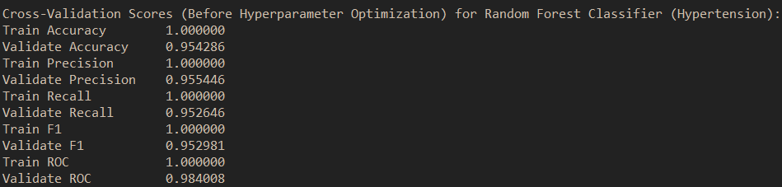
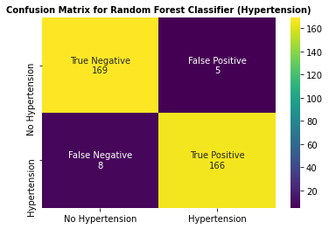
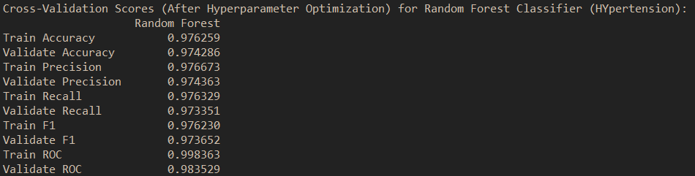
8) Retrained Model with best hyperparameter and Evaluation
Hypertension (Random Forest Classifier)
Before Hyperparameter Optimization
After Hyperparameter Optimization
Prior to the hyperparameter optimization, it was observed that the performance metrics for the training sets is slightly higher than the validation sets. This phenomenon is known as overfitting.
With the best hyperparameters, the overfitting issues has been minimized and the Random Forest Classifier has yielded with an accurate rate of 97%.
High precision rates also relates to the low-false positive rate, which is about less than 2% chances for all classes. Also, high recall rates also relates to the low-false negative rate, which can be also proven from the confusion matrix, which is also about less than 2% chances for all classes.
ROC-AUC with 98% means that the Random Forest Classifier has the excellent capability to differentiate between classes (i.e., No Hypertension and Hypertension).

Slide 26
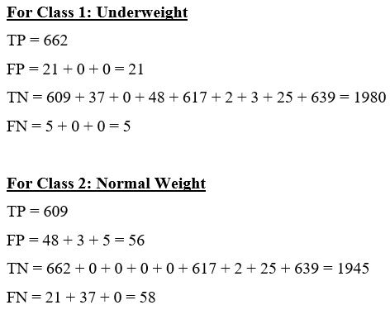
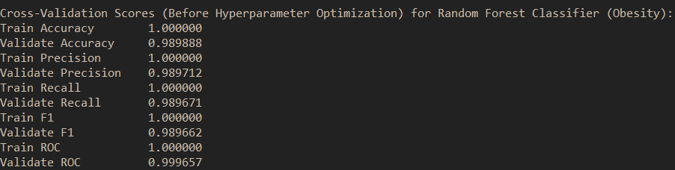
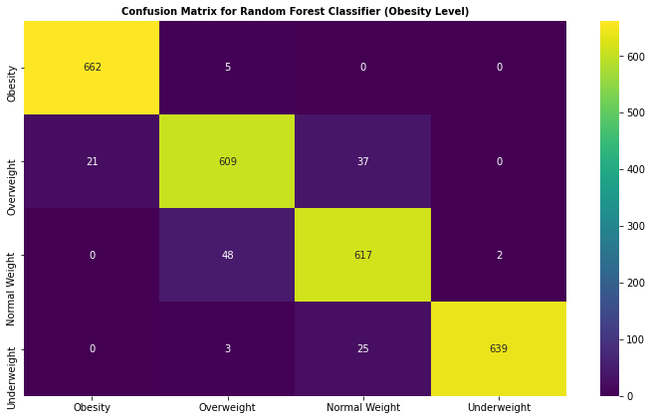
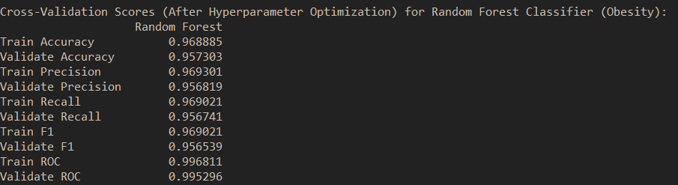
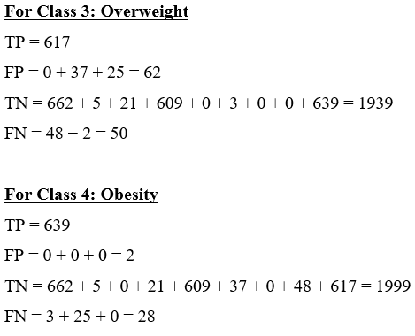
8) Retrained Model with best hyperparameter and Evaluation
Obesity (Random Forest Classifier)
Before Hyperparameter Optimization
After Hyperparameter Optimization
Prior to the hyperparameter optimization, it was observed that the performance metrics for the training sets is slightly higher than the validation sets. This phenomenon is known as overfitting.
With the best hyperparameters, the overfitting issues has been minimized and the Random Forest Classifier has yielded with an accurate rate of 97% and ROC-AUC of 99% which has an excellent capability to distinguishes between classes.
High precision rates also relates to the low-false positive rate, which is about less than 2% chances for all classes. Also, high recall rates also relates to the low-false negative rate, which can be also proven from the confusion matrix, which is also about less than 2% chances for all classes.

Slide 27

9) Evaluation of the hyperparameter Trained Models using Testing sets
Basically, a test set is a data set that is independent of the training set, but it follows the same probability distribution as the training data set.
If a model fits into training set also fits into the test data as well.
A test set is therefore a set of examples used to only assess the overall performance of the fully implemented classifiers with the best hyperparameters.
To achieve this, the final classifiers models were used to predict the classifications of examples in the test set. These predictions are then compared with the examples of true classifications in the test set to assess the model performances.

Slide 28
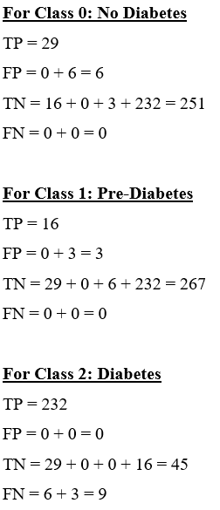



9) Evaluation on the optimized hyperparameter model using testing set
Diabetes (Gradient Boosting Classifier)
High ROC score: This model has an excellent capability to differentiate between classes (i.e., No Diabetes, Pre-Diabetes, Diabetes).
High Precision Rate: This means that the chances of misdiagnosed of diabetes (false-positive) is generally very low, which can be proven by the confusion matrix calculation.
High Recall Rate: This means that the chances of misdiagnosed of diabetes (false-negative) is also generally very low, which can also be proven by the confusion matrix calculation.
High Accuracy: This model has 97% of predicting the classes correctly with reference to the unseen testing set.
Overall, the use of Gradient Boosting Classifier to predict the likelihood of diabetes is generally acceptable.

Slide 29



9) Evaluation on the optimized hyperparameter model using testing set
Hypertension (Random Forest Classifier)
High ROC score: This model has an excellent capability to differentiate between classes (i.e., Hypertension, No Hypertension ).
High Precision Rate: This means that the chances of misdiagnosed of hypertension (false-positive) is generally very low, which can be proven by the confusion matrix.
High Recall Rate: This means that the chances of misdiagnosed of hypertension (false-negative) is also generally very low, which can also be proven by the confusion matrix.
High Accuracy: This model has 97% of predicting the classes correctly with reference to the unseen testing set.
Overall, the use of Random Forest Classifier to predict the likelihood of hypertension is generally acceptable.

Slide 30





9) Evaluation on the optimized hyperparameter model using testing set
Obesity (Random Forest Classifier)
High ROC score: This model has an excellent capability to differentiate between classes (i.e., Underweight, Normal Weight, Overweight, Obesity).
High Precision Rate: This means that the chances of misdiagnosed of obesity level (false-positive) is generally very low, which can be proven by the confusion matrix.
High Recall Rate: This means that the chances of misdiagnosed of obesity-level (false-negative) is also generally very low, which can also be proven by the confusion matrix.
High Accuracy: This model has 94% of predicting the classes correctly with reference to the unseen testing set.
Overall, the use of Random Forest Classifier to predict the likelihood of obesity level is generally acceptable.

Slide 31




10) Development of health web application
All the proposed ensemble machine learning algorithms that have been optimized and trained in Python using Spyder IDE were saved in the Pickle files.
Streamlit was used as the development and deployment of the health web application.
All the proposed machine learning algorithms were integrated with the Streamlit App as its backbone to predict the respective obesity-related chronic diseases.

Slide 32

Live Demo

